Slide 1

Geometry
Unit 3, Lesson 7 Solving Problems Using Angle Pair Relationships Volume 1, pg. 158

Slide 2


Benchmark
MA.912.GR.1.1
Prove relationships and theorems about lines and angles. Solve mathematical and real-world problems involving postulates, relationships, and theorems of lines and angles.
volume 1, pg. 158

Slide 3
Integrated Mathematical Thinking and Reasoning Standards
MA.K12.MTR.1.1 Actively participate in effortful learning both individually and collectively.
MA.K12.MTR.3.1 Complete tasks with mathematical fluency.
MA.K12.MTR.4.1 Engage in discussions that reflect on the mathematical thinking of self and others.
MA.K12.MTR.5.1 Use patterns and structure to help understand and connect mathematical concepts.
MA.K12.MTR.7.1 Apply mathematics to real-world contexts.
volume 1, pg. 158

Slide 4

Learning Target
I can solve mathematical and real-world problems involving angle pair relationships formed by transversals and parallel lines.
volume 1, pg. 158

Slide 5

Warm-Up
volume 1, pg. 158

Slide 6
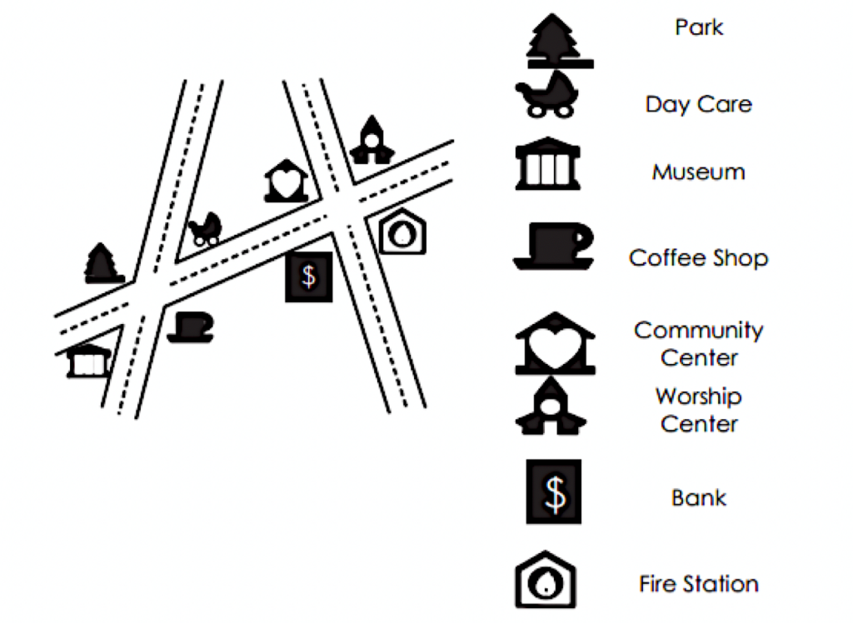
3.7.1 Warm-Up: Angle Pair Relationships
The image shows two streets intersected by a third street. Various points of interest are located at the intersections.
volume 1, pg. 158

Slide 7
Match the listed points of interest with their angle relationship listed in the right column. Write the letter of the angle relationship on the line.
Points of Interest | Angle Relationship
Museum and Worship Center | Alternate Interior Angles
Bank and Day Care | Consecutive Interior Angles
Park and Coffee Shop | Corresponding Angles
Fire Station and Worship Center | Vertical Angles
Community Center and Day Care | Alternate Exterior Angles
Bank and Museum | Linear Pair
volume 1, pg. 158

Slide 8

Collaboration
volume 1, pg. 159

Slide 9

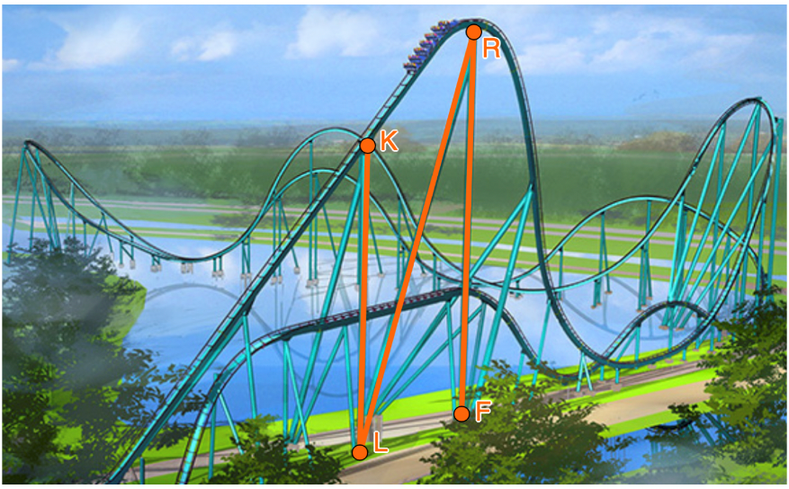
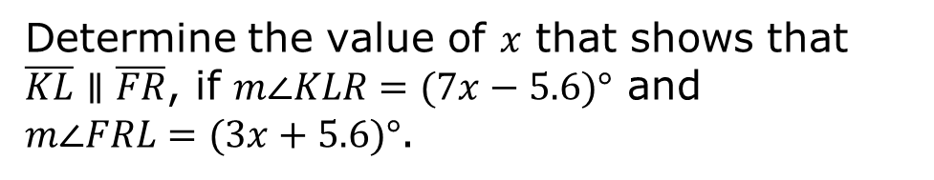
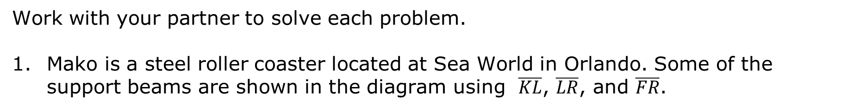
3.7.2 Collaboration: Solving Problems Using Angle Relationships
Work with your partner to solve each problem.
Mako is a steel roller coaster located at Sea World in Orlando. Some of the support beams are shown in the diagram using $\overline{KL}$, $\overline{LR}$, and $\overline{FR}$.
Determine the value of $x$ that shows that $\overline{KL}∥\overline{FR}$, if $m∠KLR=(7x−5.6)°$ and $m∠FRL=(3x+5.6)°$.
volume 1, pg. 159

Slide 10
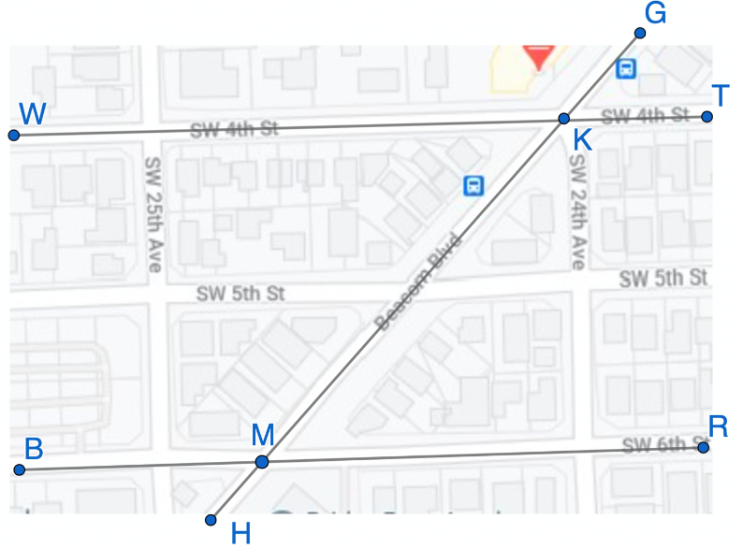
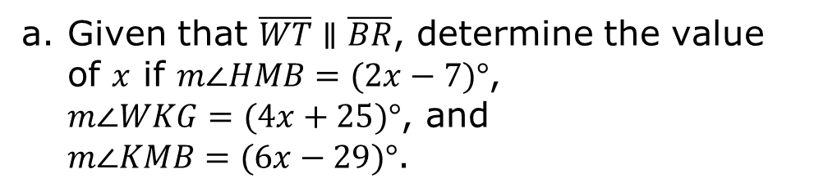
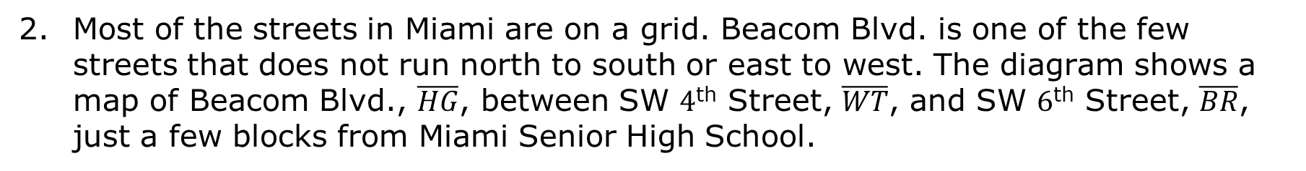
Most of the streets in Miami are on a grid. Beacom Blvd. is one of the few streets that does not run north to south or east to west. The diagram shows a map of Beacom Blvd., $\overline{HG}$, between SW $4$^{th} Street, $\overline{WT}$, and SW $6$^{th} Street, $\overline{BR}$, just a few blocks from Miami Senior High School.
Given that $\overline{WT}∥\overline{BR}$, determine the value of $x$ if $m∠HMB=(2x−7)°$, $m∠WKG=(4x+25)°$, and $m∠KMB=(6x−29)°$.
volume 1, pg. 159

Slide 11

Determine the measure of each angle.
$$m∠HMB$$
$$m∠HMR$$
$$m∠TKM$$
volume 1, pg. 160

Slide 12
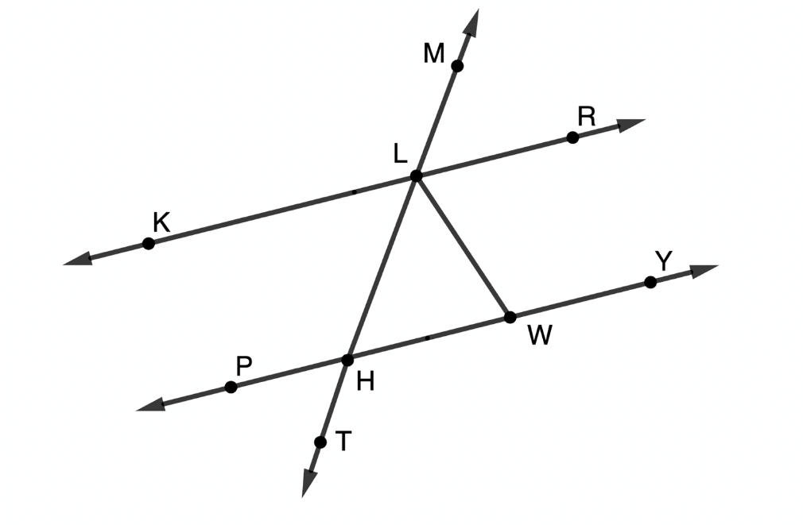

$\overset{⃡}{KR}$, $\overset{⃡}{PY}$, and $\overset{⃡}{MT}$ are shown with $\overline{LW}$ where $m∠LWH=(4y−9\frac{1}{3})°$, $m∠WLH=(3y+3)°$, and $m∠LHW=m∠WLH$.
Determine the value of $y$ that shows that $\overline{PY}∥\overline{KR}$.
volume 1, pg. 160

Slide 13

Determine the measure of each angle.
$$m∠RLW$$
$$m∠PHT$$
$$m∠KLM$$
volume 1, pg. 161

Slide 14

Your Turn
volume 1, pg. 161

Slide 15
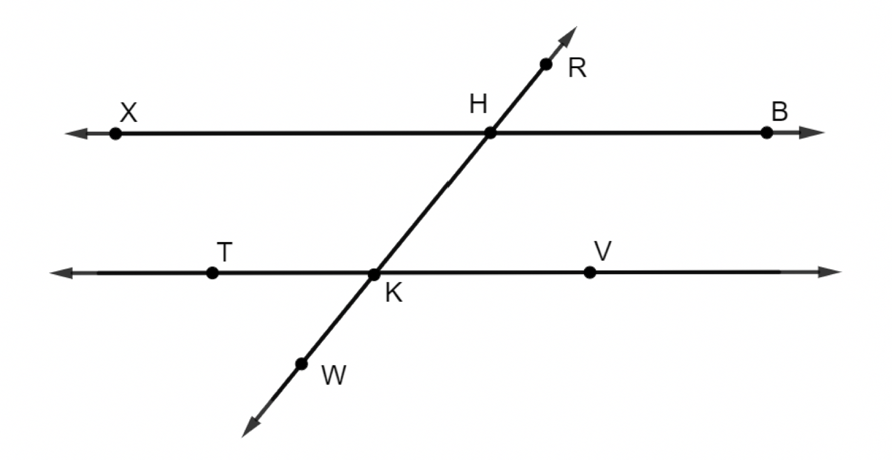
3.7.3 Your Turn!
$\overset{⃡}{XB}$, $\overset{⃡}{TV}$, and $\overset{⃡}{RW}$ are shown. $\overset{⃡}{XB} ||\overset{⃡}{TV}$ where $\overset{⃡}{RW}$ is a transversal with $m∠XHR=(9x+21)°$ and $m∠HKV=(4x+3)°$.
volume 1, pg. 161

Slide 16
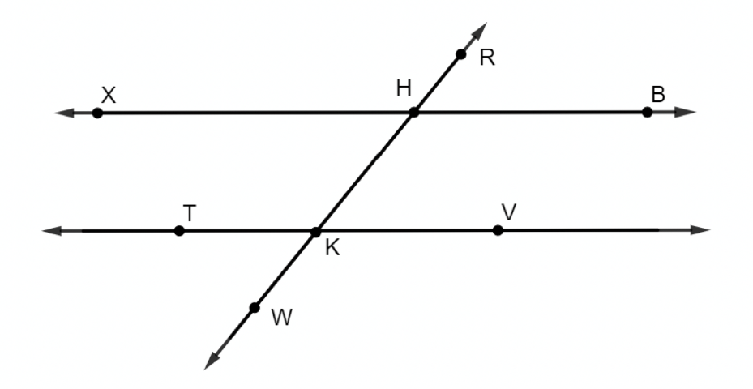
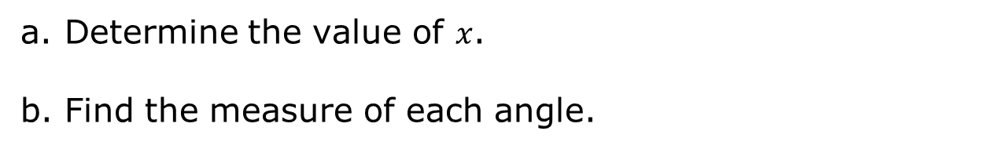
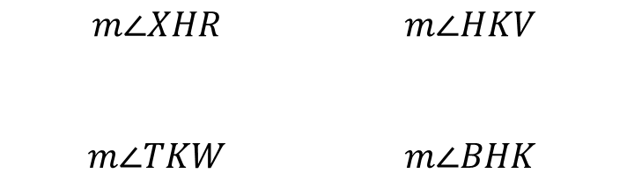
Determine the value of $x$.
Find the measure of each angle.
$$m∠XHR$$ | $$m∠HKV$$
$$m∠TKW$$ | $$m∠BHK$$
volume 1, pg. 161

Slide 17
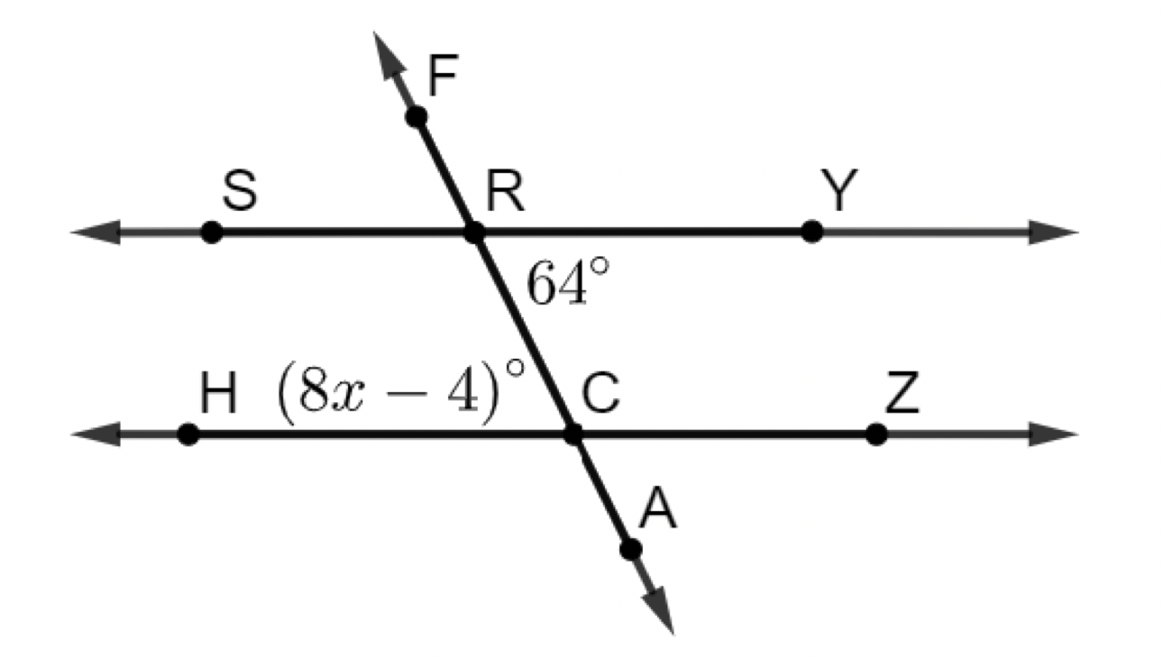
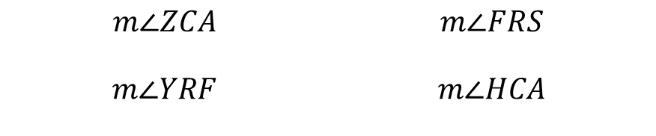
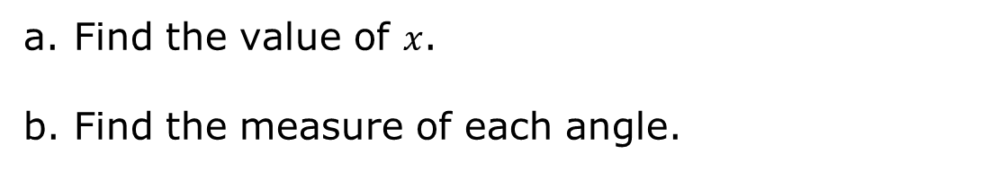
$\overset{⃡}{SY}∥\overset{⃡}{HZ}$, $m∠YRC=64°$, and $m∠RCH=(8x−4)°$.
Find the value of $x$.
Find the measure of each angle.
$$m∠ZCA$$ | $$m∠FRS$$
$$m∠YRF$$ | $$m∠HCA$$
volume 1, pg. 162

Slide 18
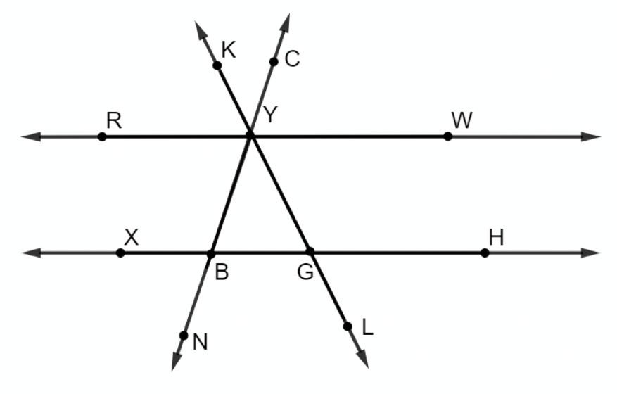

$\overset{⃡}{RW}∥\overset{⃡}{XH}$, $m∠RYK=s°$, $m∠CYW=m°$, $m∠GYB=43°$, $m∠YBG=72°$, and $m∠LGH=(6t+11)°$.
Find the value of each variable. Show your work.
$$t$$
$$m$$
$$s$$
volume 1, pg. 162

Slide 19
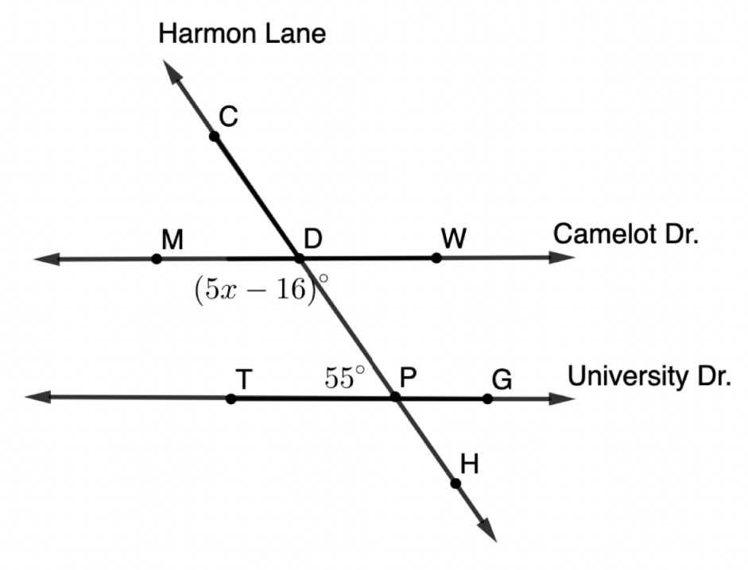
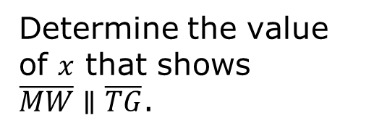
Harmon Lane, $\overset{⃡}{CH},$ crosses the streets Camelot Drive, $\overset{⃡}{MW}$, and University Drive,$\overset{⃡}{TG}$, as shown. $m∠TPD=55°$, and $m∠MDP=(5x−16)°$.
Determine the value of $x$ that shows $\overline{MW}∥\overline{TG}$.
volume 1, pg. 163

Slide 20

Wrap-Up
volume 1, pg. 163

Slide 21
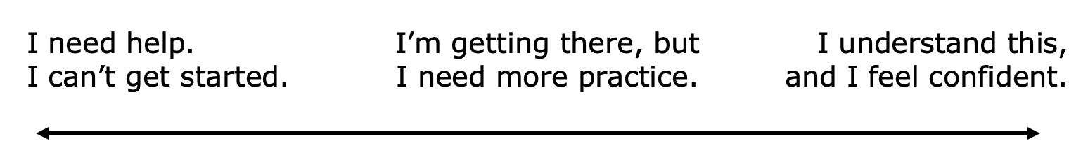
3.7.4 Wrap-Up: Reflection
Draw an X on each line to indicate where your current learning is related to each target.
I can use corresponding angles to determine angle measurements.
I can use alternate interior angles to determine angle measurements.
volume 1, pg. 163

Slide 22
I can use alternate exterior angles to determine angle measurements.
I can use consecutive interior angles to determine angle measurements.
I can use consecutive exterior angles to determine angle measurements.
volume 1, pg. 163

